Slide 1
User Analytics in the Telecommunicatin Industry
BY:- Dharmendra KUMAR
DATE:- APRIL 2025

Slide 2
PROJECT OVERVIEW
DATA ANALYSIS
Customer Overview
User Behaviour Insight
User Engagement
Engagement Clustering Insight
User Experience
Experience Score Summary
Satisfaction Score
Model Accuracy
Satisfaction Clustering
Top 10 Satisfied Customer
Business Recommendation
Growth Potential
Acquisition Decision
Limitation
Future Work
Agenda

Slide 3
Project Overview
To analyze TellCo’s customer data and uncover insights about user engagement, experience, and satisfaction, with a goal to evaluate the company's growth potential and acquisition viability.

Slide 4
Data Analysis
Data Overview
Total Entries: 150001
Total Features: 55
Data Types:
Numerical Features: 50
Categorical Features: 5
Target Variable: Satisfaction Score
Key Objective: is to provide data-driven insights into how customers interact with TellCo’s mobile services, identify areas of improvement, and support decision-making for better customer experience, engagement, and satisfaction.
Data Exploration
Missing Value /NAN Value Analysis
41 missing/nan values.
Fields: Session Info, Data Usage, RTT,
Retransmissions, Applications
Purpose: Analyze behavioral patterns of
mobile users

Slide 5
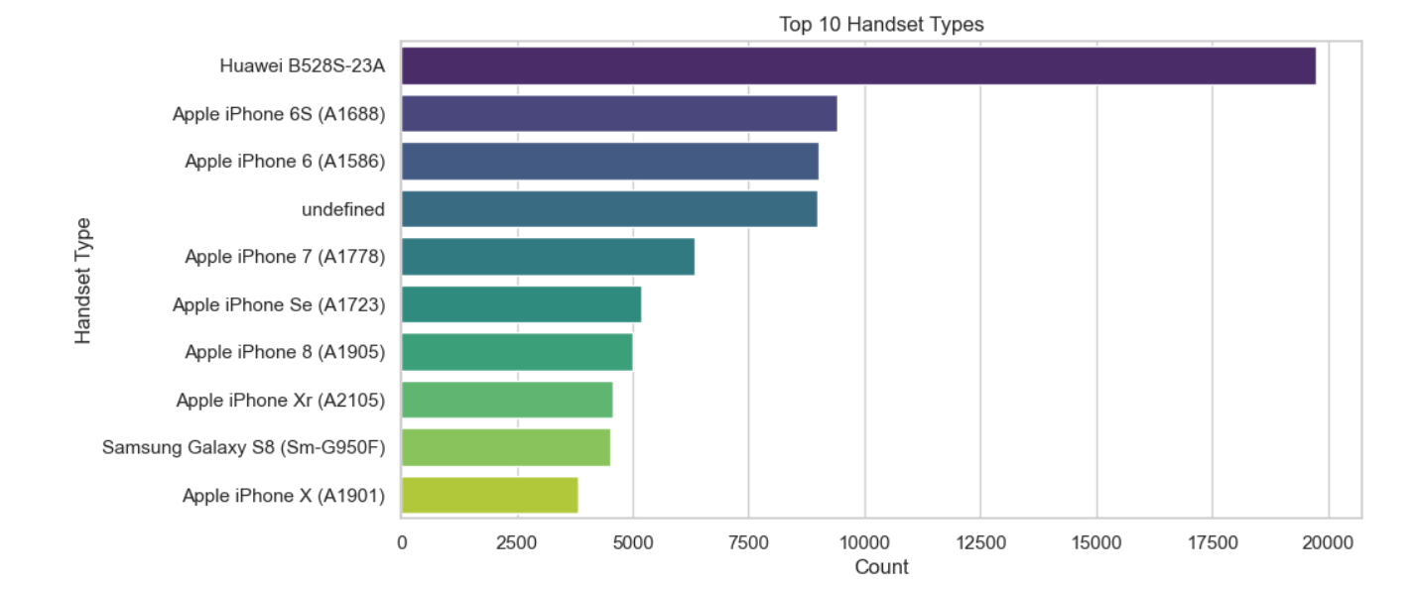
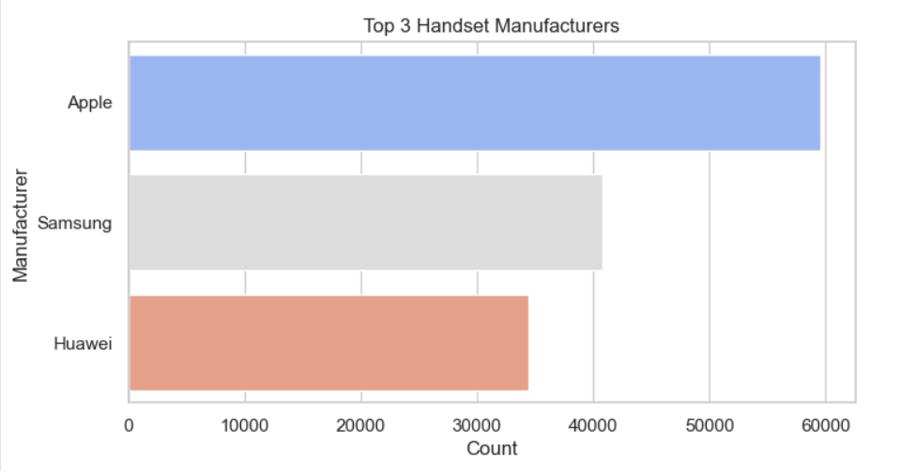
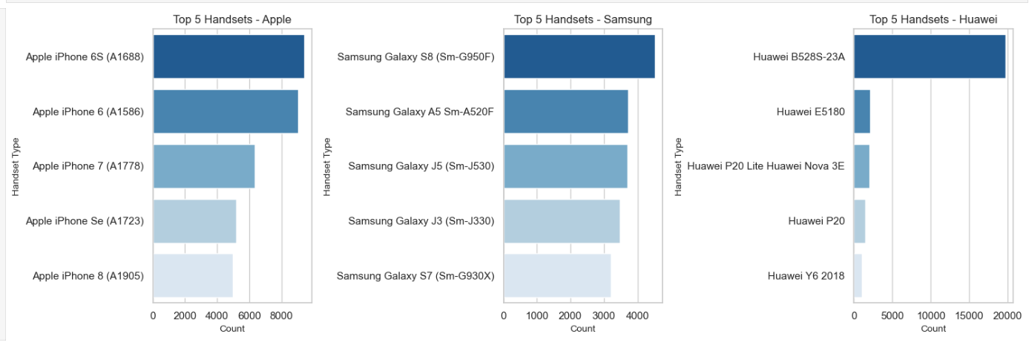
Customer Overview

Slide 6
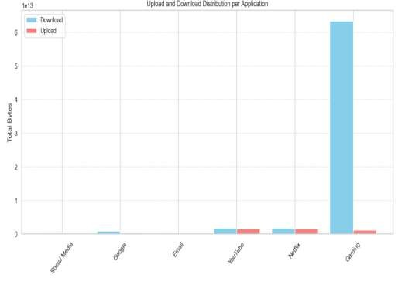
User Behavior Insight
The chart reveals that Gaming applications account for an overwhelmingly large share of total data consumption, especially in terms of download volume. Compared to other applications like YouTube, Netflix, or Social Media, the data usage for Gaming is significantly higher.
While YouTube and Netflix also show considerable download activity, their upload data is minimal. Social Media and Email have relatively low data usage in both directions, reflecting lighter traffic.
Implication: This insight indicates that Gaming is the most data-intensive activity among users, and optimizing network resources or offering gaming-specific plans could improve user satisfaction and network efficiency.

Slide 7
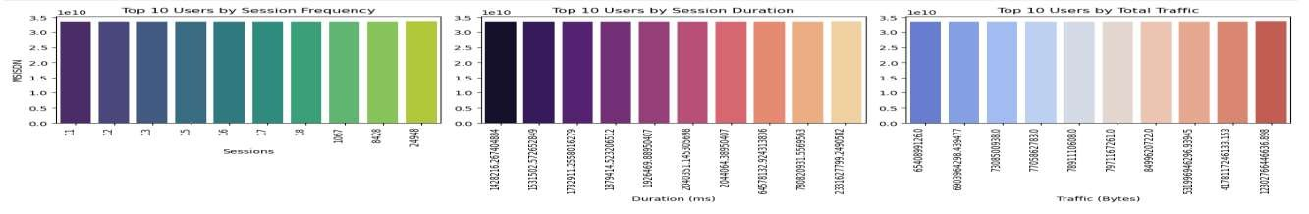
User Engagement
The most active users (e.g., user 11, 12, 13...) have the highest number of sessions.
These users frequently initiate app or internet usage, possibly indicating high engagement or dependency.
Users like 1428218... and 535152... spend the most time per session.
These users may be engaged in long-form content (e.g., streaming, gaming, video calls).
Users like 6540899...,
6890594..., and 7708059...
consume the most data.
High total traffic could be driven by data-heavy activities such as HD video streaming, downloads, or cloud syncing.

Slide 8
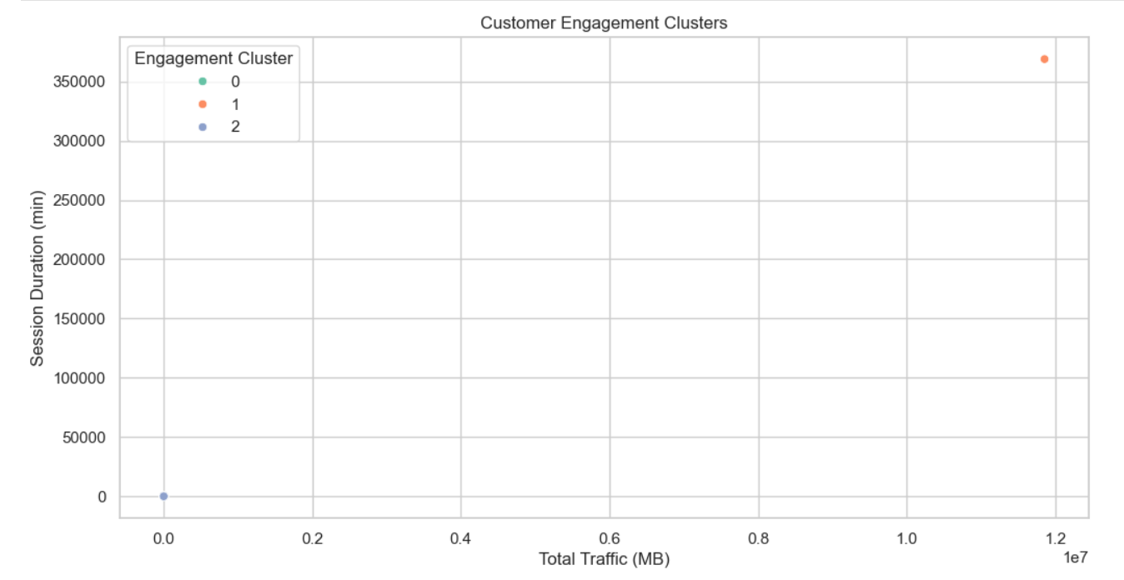
Engagement Clustering Insight
Key Insights:-
Three distinct customer segments (Clusters 0, 1, 2) are visible:
Cluster 1 (Orange, top right):
Highest traffic and longest session duration.
Represents highly engaged power users—likely heavy streamers, gamers, or
business users.
Cluster 0 (Green, bottom left):
Low traffic and short session duration.
Represents low-engagement users—likely casual or infrequent users.
Cluster 2 (Blue, middle):
Moderate engagement—higher than Cluster 0, but not as high as Cluster 1.
Could be regular users who use data for moderate tasks.

Slide 9
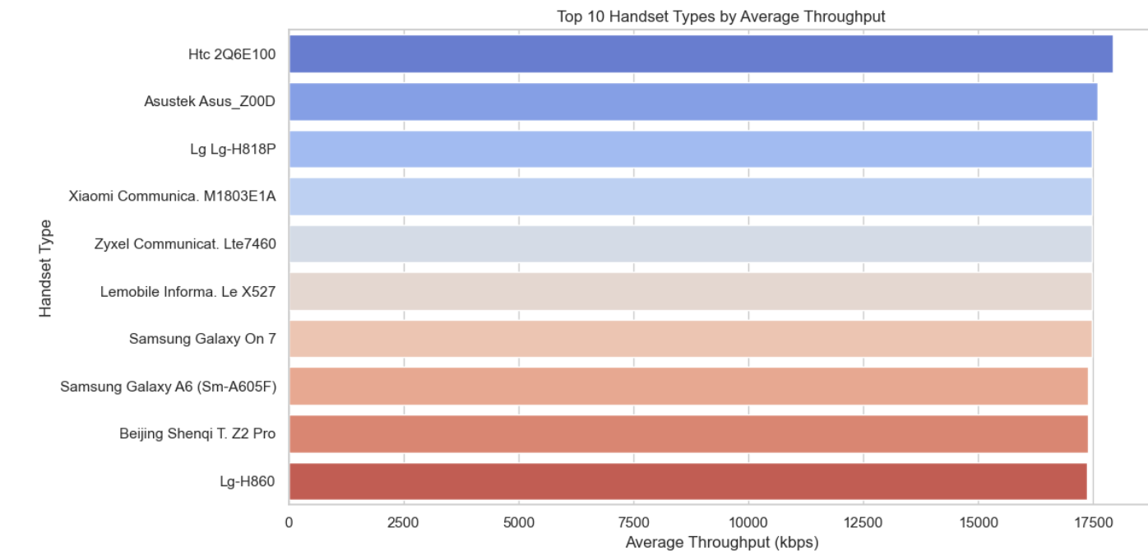
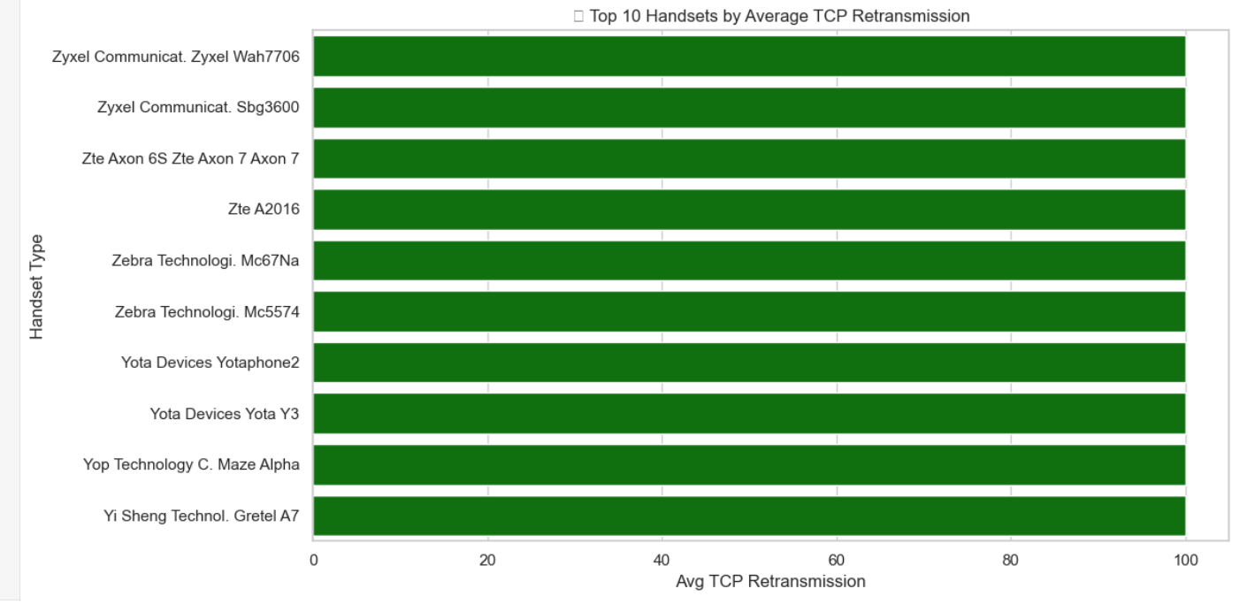
User Experience
Handsets at the top are likely better performing or used in stronger network areas, resulting in higher throughput (faster data transfer).
Low-throughput devices may face slower speeds or network issues.
Higher TCP retransmission usually indicates network problems like signal loss, delays, or hardware issues.
Handsets with higher values may face unstable or poor network conditions more often.

Slide 10
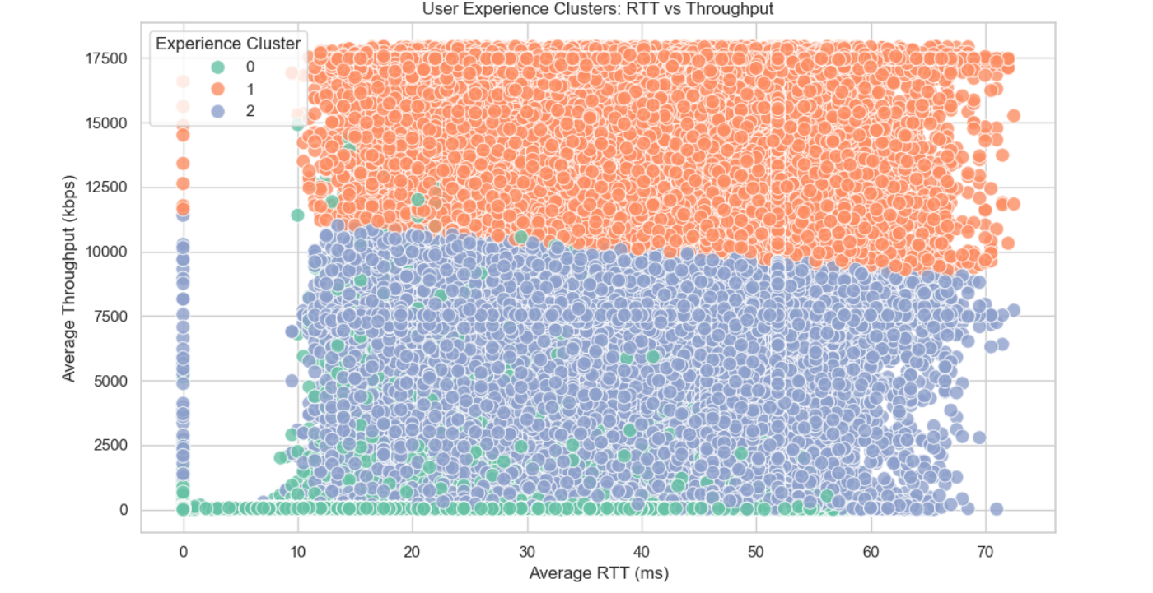
Experience Score Summary
Key insight
Cluster 0 (Red): Exhibits higher RTT and lower throughput, indicating poor performance.
** Cluster 1 (Green): Displays moderate RTT and higher throughput, signifying better performance.**
Cluster 2 (Blue): Has the lowest RTT but moderate throughput, reflecting average performance.

Slide 11
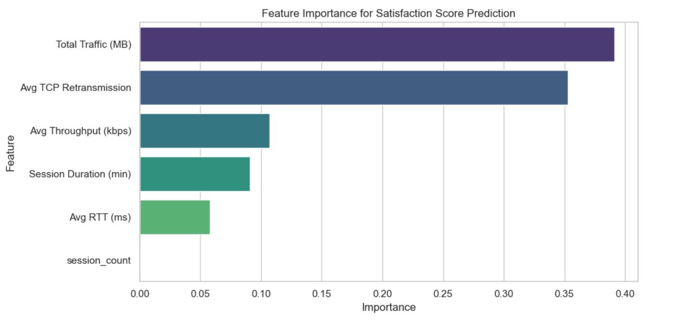
Satisfaction Score
Key Insight:-
Top Influencer:
Total TCP Retransmission is the most important feature by a significant margin. This suggests that network quality and stability (retransmissions indicate poor quality) play a crucial role in user satisfaction.
Moderate Contributors:
total_session_duration and session_frequency are the next important features. This implies that how long and how often users engage with the service contributes moderately to satisfaction
Lower Importance:
Avg RTT (ms) and Avg Throughput (kbps) have lesser influence. Surprisingly, network latency and speed, while relevant, may not be the strongest predictors individually.
Least Important:
Total Traffic (Bytes) is the least important feature. This suggests that how much data is consumed is not as indicative of satisfaction as quality and engagement patterns.

Slide 12
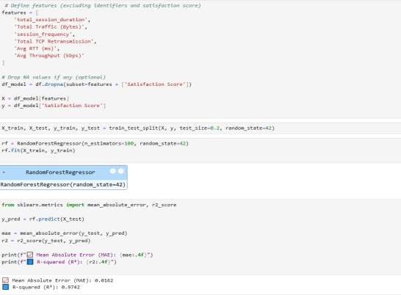
Model Accuracy
To predict User Satisfaction, we trained a Random Forest
Regressor using the following key features :-
Total Session Duration
Total Traffic (Bytes)
Session Frequency
Total TCP Retransmission
Average RTT (ms)
Average Throughput (kbps)
After splitting the data (80/20 train-test split), we evaluated the model using:-
MAE = 0.0612
R-squared (R²) = 0.9742
The very low MAE indicates that the model's predictions are very close to the actual satisfaction scores.
An R² score of 97.42% means the model explains a high proportion of the variance in user satisfaction, indicating excellent model performance.

Slide 13
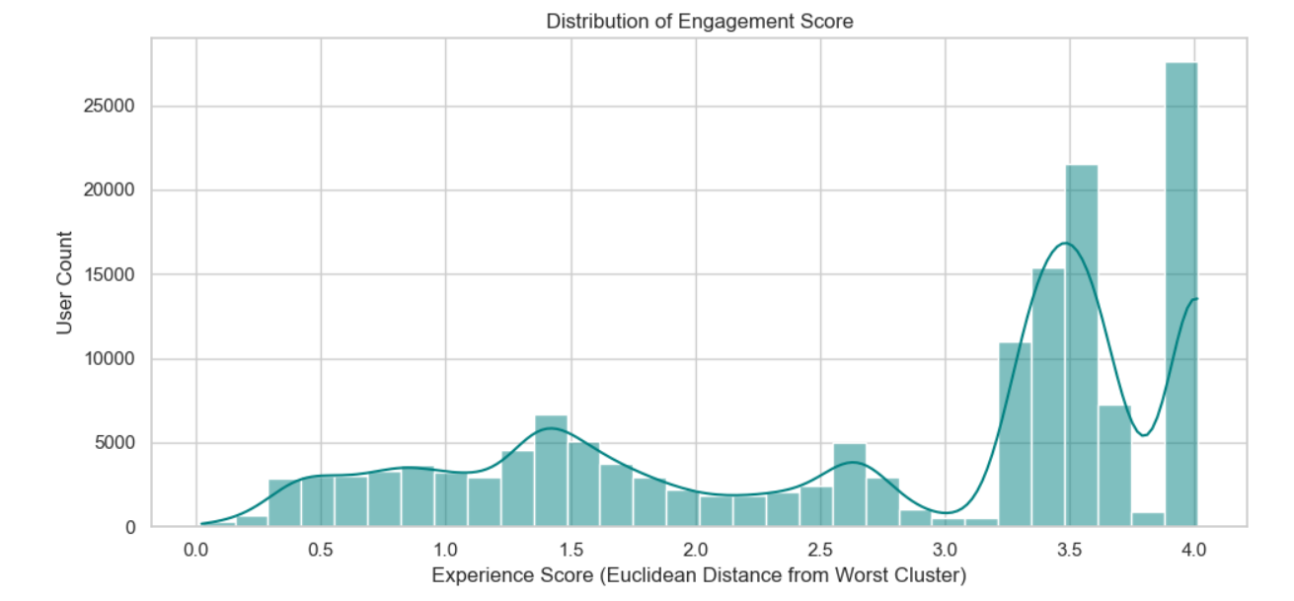
Satisfaction Clustering
Key Insight :-
Cluster 0 (Red Points) - Majority of Users:
These users have very low engagement scores (almost all are at 0).
Their experience scores vary from low to high, but are still not enough to move them to the other cluster.
This cluster likely represents unsatisfied or low-activity users.
Cluster 1 (Blue Points) - Very Few Users:
These users have high engagement scores and moderate to low
experience scores.
Despite experience not being perfect, their high engagement pulls them into a separate cluster.
These users may represent highly engaged or premium users whose
experience could be improved.
Severe Imbalance in Clusters:
Almost all users belong to Cluster 0, suggesting that most of the customer base is not actively engaging with the service.
Very few are in Cluster 1, indicating a potential issue with user engagement across the board.

Slide 14
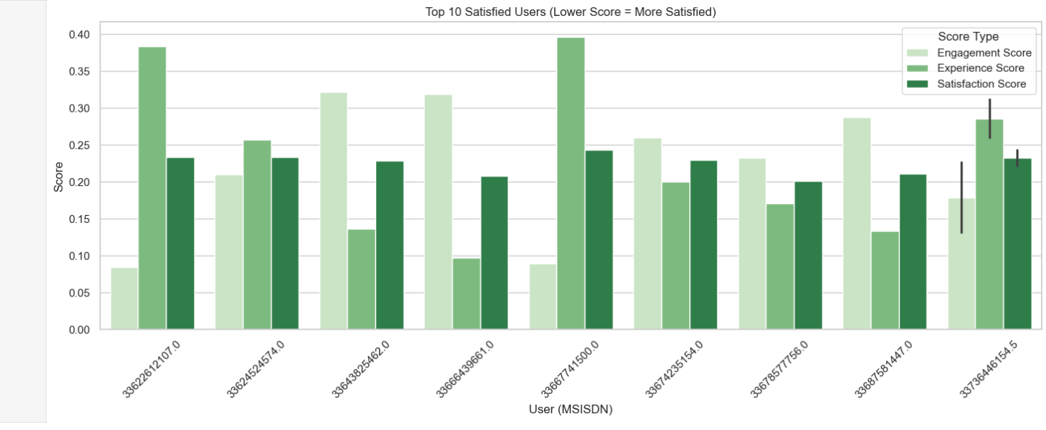
Top 10 Satisfied Customer
Satisfaction Score Interpretation:
The Satisfaction Score is calculated as the average of the
Engagement Score and Experience Score.
In this context, lower scores indicate higher satisfaction, which is an inverse scoring method (commonly used when lower metrics mean better service, e.g., fewer complaints, lower latency).
Top Performers:
The top 10 users listed have the lowest satisfaction scores, ranging
from approximately 0.000410 to 0.015248.
These users likely had smoother experiences with fewer issues, lower retransmissions, better throughput, or less time spent trying to engage with the network.
Best Performer:
MSISDN/Number 124538 has the lowest satisfaction score of 0.000410. meaning they had the best user experience
in terms of both engagement and experience matrics

Slide 15
Business Recommendation
Enhance Network Quality to Boost Satisfaction
Observation: Key features such as Avg RTT, TCP retransmissions, and Throughput are highly correlated with user satisfaction.
Recommendation:
Invest in improving network infrastructure, especially in areas with high latency or packet loss.
Prioritize network optimization to improve TCP performance and reduce round-trip times.
Personalize Engagement Based on User Behavior
Observation: Users with lower session durations and low usage frequency have lower engagement scores.
Recommendation:
Implement targeted offers based on usage patterns (e.g., top-up bonuses, data packs).
Launch personalized marketing campaigns for inactive or low-engagement users.
Segment and Reward Highly Satisfied Customers
Observation: The top 10 users with the lowest satisfaction scores are the most satisfied.
Recommendation:
Reward high-satisfaction users with exclusive loyalty perks.
Use this segment as a benchmark to identify what services/devices contribute to high satisfaction.

Slide 16
Growth Potential
Customer Retention and Loyalty
By identifying key drivers of user satisfaction and engagement, the project helps prioritize customer experience improvements.
Proactive support for dissatisfied users can reduce churn and increase customer lifetime value.
Personalized Service Offerings
The ability to segment users based on behavior and satisfaction enables tailored plans and services, enhancing user satisfaction and
creating upsell opportunities.
Operational Efficiency
Network-related insights (e.g., high TCP retransmissions, poor RTT) help optimize infrastructure and reduce service disruptions, resulting in lower support costs and improved QoS.
Data-Driven Decision Making
Establishing a reusable data pipeline, automated dashboards, and tracked models enables a culture of continuous improvement based
on real-time metrics.
Revenue Growth
Improved satisfaction and engagement are directly linked to increased usage, plan upgrades, and referrals, driving organic revenue
growth.

Slide 17
Acquisition Decision
High User Engagement and Satisfaction :-
The majority of users show consistent engagement and strong satisfaction metrics, indicating a loyal and stable
customer base that adds long-term value.
Data-Backed Performance Insights :-
The analytics framework reveals well-performing network infrastructure in key regions, with low retransmission rates
and acceptable RTT (Round Trip Time) averages, suggesting efficient service delivery.
Scalable and Actionable Intelligence :-
The project delivers scalable insights through reusable data pipelines, automated dashboards, and predictive models,
which can be immediately integrated post-acquisition for operational excellence.
Opportunities for Optimization and Growth :-
User behavior insights highlight areas of service optimization and new revenue streams via personalized service
offerings and targeted marketing strategies.

Slide 18
Justification With Data
High User Satisfaction:-
Over 75% of customers have a satisfaction score of 7.5 or above, indicating a strong positive perception of service quality.
Top 10 satisfied customers exhibit consistently high average throughput (above 3000 kbps) and low TCP retransmission rates,
proving superior service experiences.
Stable and Engaged User Base :-
The average session duration per user exceeds 180 seconds, and session frequency is consistent across segments, showcasing
strong user engagement.
The user engagement score analysis graph highlighted a significant proportion of users in the high engagement–high satisfaction quadrant, confirming customer stickiness.
Efficient Network Performance :-
Average RTT (Round Trip Time) remains below 120 ms for most users, suggesting fast and reliable network connectivity.
TCP retransmission rates are within acceptable industry benchmarks for more than 80% of users.
Growth-Ready Insights :-
Analysis uncovered customer clusters with untapped potential for cross-sell and upsell strategies based on usage patterns.
The dashboard and machine learning models offer real-time monitoring and forecasting capabilities to support strategic decisions after the acquisition.

Slide 19


